Slide 1
Hazardous Materials: Overview
1

Slide 2
Objectives (1 of 2)
1
Define a hazardous material.
Define weapons of mass destruction (WMD).
Describe the levels of hazardous materials training: Awareness, operations, technician, specialist, and incident commander.

Slide 3
Objectives (2 of 2)
1
Understand standards vs. federal regulations that govern hazardous materials response activities.
Explain why hazardous materials incidents differ from other emergencies.
Explain the need for a planned response to a hazardous materials incident.

Slide 4
The Responders (1 of 2)
1
Fire fighters
Law enforcement personnel
Emergency medical services personnel

Slide 5
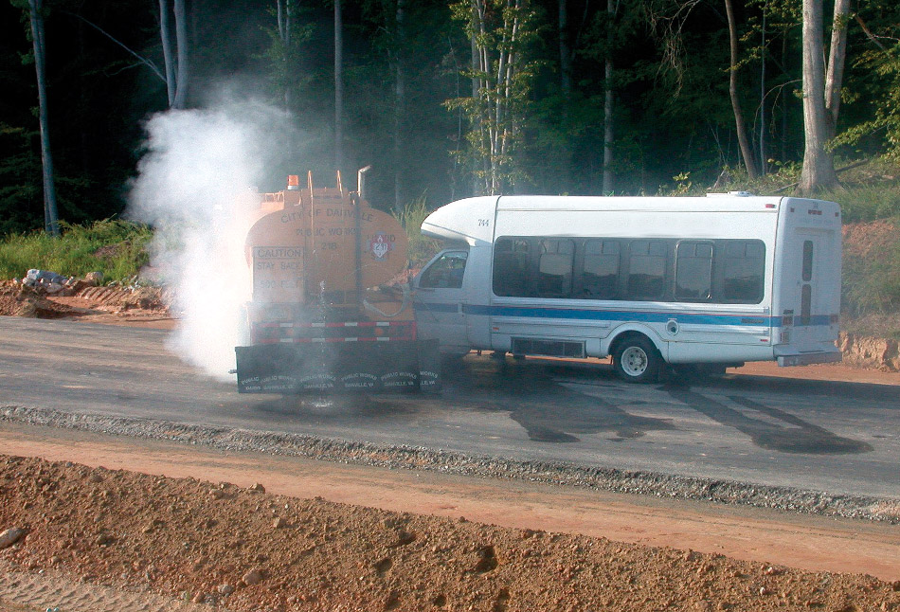
The Responders (2 of 2)
1
The ability to recognize a potential hazardous material/WMD incident is a critical first step to ensuring your safety.
Notes:
Image: Courtesy of George Roarty/VDEM

Slide 6
Hazardous Materials or WMD Involvement
1
Changes the nature of the incident
Changes the responder’s mentality

Slide 7
Course Goals
1
Recognize hazardous material/WMD incidents
Take initial actions (e.g., establish scene control zones)
Implement the Incident Command System
Use basic reference sources (e.g., ERG)
Perform appropriate decontamination
Understand the roles in full-scale response

Slide 8
Authority Having Jurisdiction (AHJ)
1
Sets operational policy
Sets procedures
For jurisdiction in which you operate

Slide 9
Governmental Entities
1
Occupational Safety and Health Administration (OSHA)
Environmental Protection Agency (EPA)
Issue regulations concerning hazardous materials emergencies
Enforce these regulations

Slide 10
OSHA Regulations
1
Mandatory, government-issued, enforced
Each U.S. state may choose to adopt/supersede OSHA workplace health and safety regulations
State-plan states: Adopt OSHA regulations
Non-plan states: Follow Title 40, CFR

Slide 11
EPA Regulations
1
EPA regulates/governs issues related to hazardous materials in the environment
CFR Title 40, Protection of the Environment, Part 311, Worker Protection (EPA’s version of OSHA HAZWOPER)

Slide 12
NFPA Standards
1
Voluntary
Consensus-based (public can comment on standards before they are adopted)
Technical committee meets regularly to revise/update/change the standards
Agencies adopt entirely or in part

Slide 13
Hazardous Materials (1 of 2)
1
Hazardous materials pose a risk to
Health
Safety
The environment

Slide 14
Hazardous Materials (2 of 2)
1
Hazardous materials pose a risk when
Transported in commerce
Used incorrectly
Not properly contained or stored

Slide 15
Weapons of Mass Destruction (WMD)
1
Criminal use of hazardous materials, including:
Illicit laboratories
Environmental crimes
Industrial sabotage

Slide 16
Where are Hazardous Materials? (1 of 2)
1
They can be found anywhere
e.g., 5000-gallon leak of milk into water body poses unreasonable threat to environment
Commonly sold industrial chemicals, household cleaners, lawn care products
Manufacturing also creates harmful waste

Slide 17
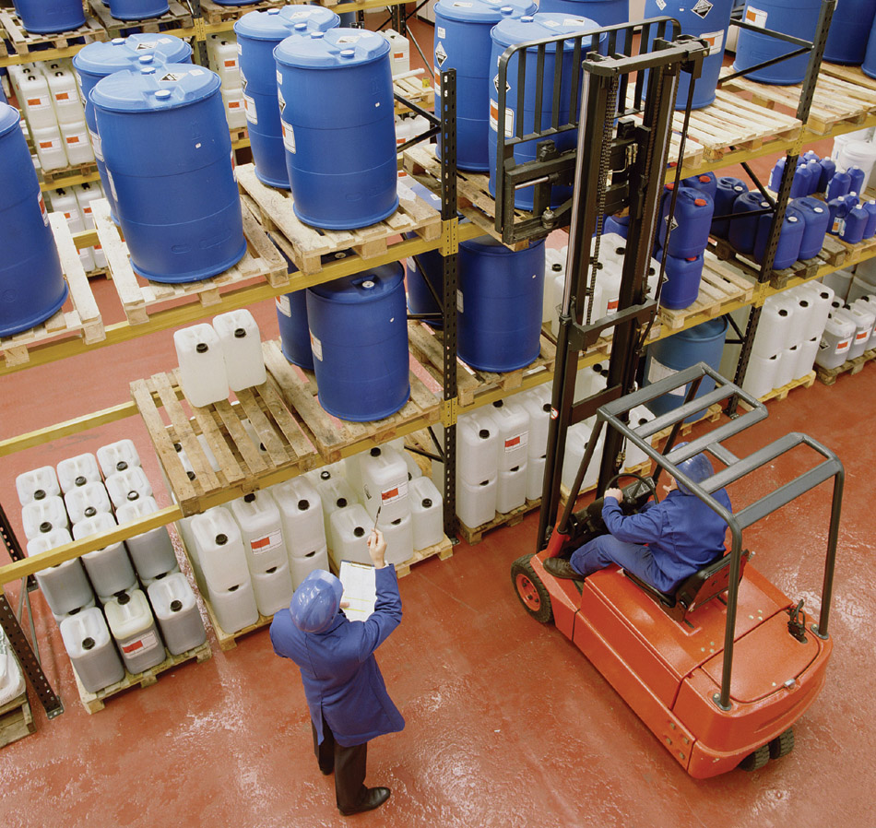
Where are Hazardous Materials? (2 of 2)
1
A hazardous material can be found anywhere.
Notes:
Image: © Steve Allen/Brand X Pictures/Alamy Images

Slide 18
Questions to Ask in Chemical Release
1
Answers to these questions will inform response to hazardous materials incident
What is the chemical?
How was it released?
What will it do next?

Slide 19
OSHA Hazardous Materials/WMD Response Regulations
1
HAZWOPER (HAZardous Waste OPerations and Emergency Response)
Found in CFR 29 1910.120
Training levels: Awareness, operations, technician, specialist, incident commander
Revised less frequently than NFPA 472

Slide 20
Awareness Level Personnel (1 of 3)
1
Could encounter hazardous materials/ WMD emergency
Recognize presence of hazardous materials/WMD
Secure the area and protect themselves
Call for trained personnel

Slide 21
Awareness Level Personnel (2 of 3)
1
Not “responders”; function in support roles
Detect presence of hazardous materials/WMD
Identify substance involved
Use ERG to research the hazard at hand

Slide 22
Awareness Level Personnel (3 of 3)
1
Not “responders”; function in support roles
Initiate and implement protective actions consistent with plan, procedures, and ERG
Initiate notification process

Slide 23
HAZWOPER Regulations for Awareness Level Personnel (1 of 2)
1
HAZWOPER considers awareness level to be “responders”
Have knowledge of hazardous substances and associated risks
Understand potential outcomes of incident
Recognize presence of hazardous material

Slide 24
HAZWOPER Regulations for Awareness Level Personnel (2 of 2)
1
HAZWOPER considers awareness level to be “responders”
Understand role of awareness level individual in emergency response plan
Can assess need for additional resources and notify the communication center
Annual refresher training required

Slide 25
Operations Level Responders
1
Respond to hazardous materials/WMD emergencies
Protect persons, environment, or property
May have competencies specific to mission, expected tasks, equipment, and training (determined by AHJ)

Slide 26
Core Competencies of Operations Level Responders (1 of 2)
1
Analyze incident scene, determine scope of emergency
Identify containers and materials involved
Use reference sources (e.g., ERG)
Predict behavior of hazardous material
Estimate potential incident outcomes

Slide 27
Core Competencies of Operations Level Responders (2 of 2)
1
Plan response to substance release, select correct level of PPE
Perform decontamination
Preserve evidence
Evaluate status and effectiveness of the response

Slide 28
HAZWOPER Regulations for Operations Level Responders (1 of 3)
1
Must be trained to respond in a defensive fashion
Do not stop the release directly
Keep a safe distance from substance
Prevent spread of hazardous material
Prevent/reduce potential human exposures

Slide 29
HAZWOPER Regulations for Operations Level Responders (2 of 3)
1
Must be trained to respond in a defensive fashion
Conduct hazard/risk assessment
Select proper PPE
Know basic hazardous materials terms

Slide 30
HAZWOPER Regulations for Operations Level Responders (3 of 3)
1
Must be trained to respond in a defensive fashion
Control, contain/confine using available resources
Perform decontamination
Understand relevant standard operating and termination procedures

Slide 31
Superfund Amendments and Reauthorization Act of 1986
1
Created method and standard practice for a local community to understand chemical hazards in the community
Title III: Emergency Planning and Community Right to Know Act (EPCRA)
Businesses must report storage type, quantity, and methods to fire dept. and local emergency planning committee

Slide 32
Other Governmental Agencies (1 of 3)
1
Department of Transportation (DOT)
Promulgates/publishes laws and regulations governing transportation of goods by highway, rail, pipeline, air, and sometimes marine transport

Slide 33
Other Governmental Agencies (2 of 3)
1
Local Emergency Planning Committee (LEPC)
Gathers and disseminates information about hazardous materials to public
Composed of volunteers from industry, transportation, media, fire, police, public
Collect Material Safety Data Sheet (MSDS)

Slide 34
Other Governmental Agencies (3 of 3)
1
State Emergency Response Commission (SERC)
Acts as liaison between local and state levels of authority
Fire and police service, elected officials
Collects and disseminates information relating to hazardous materials emergencies

Slide 35
Material Safety Data Sheet (1 of 2)
1
Important resource for responders
Detailed profile of chemical/mixture
Provided by manufacturer/supplier
Describes physical and chemical properties
Gives toxicology data

Slide 36
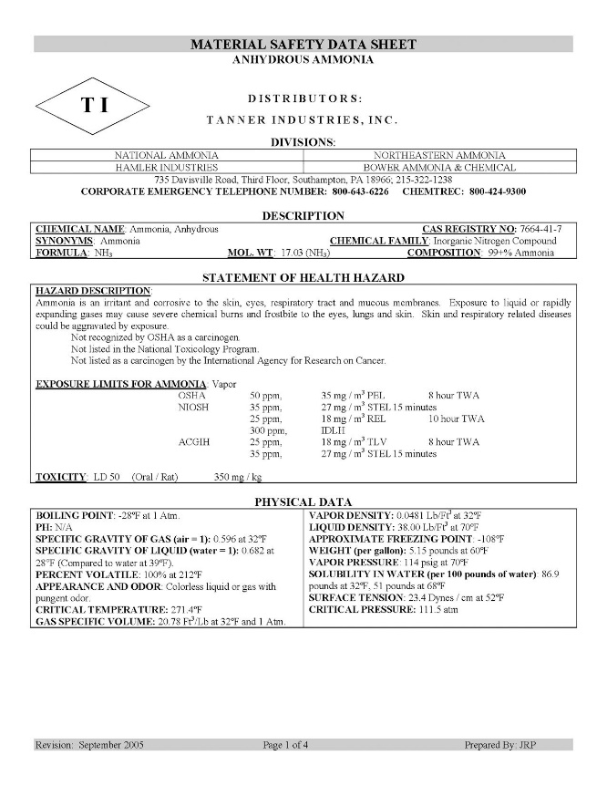
Material Safety Data Sheet (2 of 2)
1
Contains information about chemical composition, physical and chemical properties, health and safety hazards, emergency response, and waste disposal of a material.
Notes:
Image: Courtesy of Tanner Industries, Inc., Southhampton, PA

Slide 37
Response to Hazardous Materials/WMD Emergency
1
Requires a different mindset
Generally takes more time
Bear in mind role of law enforcement, presence of on-scene evidence
Begins with training before incident

Slide 38
Preplanning (1 of 2)
1
Focus on target hazards in community
Discuss/share information with LEPC
Determine cohesive emergency response plan, before a large-scale incident occurs

Slide 39
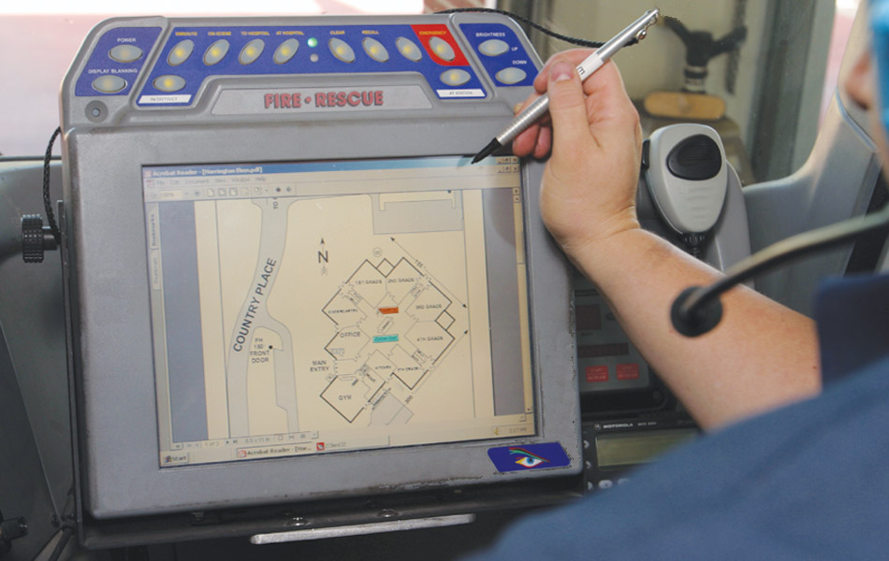
Preplanning (2 of 2)
1
Conduct preincident planning activities at target hazards throughout the jurisdiction.

Slide 40
Summary (1 of 4)
1
Hazardous materials pose risk to health, safety, or environment
OSHA and EPA: Issue and enforce hazardous materials regulations
NFPA: Issue and enforce consensus-based hazardous materials/WMD standards

Slide 41
Summary (2 of 4)
1
Response actions are dictated by behavior of chemical released
NFPA 472 and 473: Relate to hazardous materials/WMD incident response
OSHA HAZWOPER: CFR 29 1910.120
EPA’s version: CFR 40

Slide 42
Summary (3 of 4)
1
Awareness level personnel
Recognize hazard, isolate area, call for assistance
Operations level responders
Core competencies: Defensive actions
Mission-specific: PPE, decontamination, evidence preservation, air monitoring, etc.

Slide 43
Summary (4 of 4)
1
Hazardous materials technicians
Mitigate emergency
Incident commander
Responsible for all incident activities

