Slide 1
Essentials of Fire Fighting
6th Edition
Firefighter I
Chapter 19 — Fire Origin and Cause Determination

Slide 2
Learning Objective 1
Explain ways to recognize obvious signs of the area of origin.

Slide 3
The area of origin contains several pieces of important information.
Area of origin
Assume
Potentially lethal concentrations of gas present
Greatest amount of damage, debris
Precise point of origin, ignition
Monitor air
Wear full PPE

Slide 4
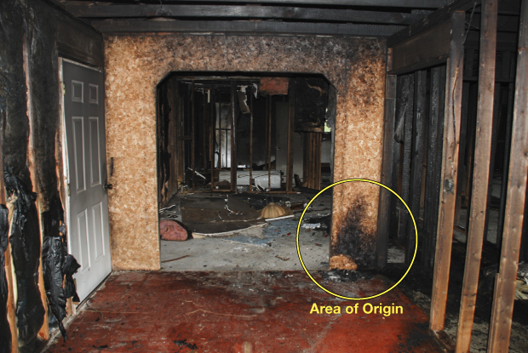
Debris on scene contains fire cause indicators and must remain in place.
May be used in court
Arson – Criminal charges
Courtesy of Donny Howard

Slide 5
You must control evidence and remember information from the incident as much as possible.
Control evidence
Chain of custody
Required in legal cases
Remember from on scene – What you
See
Hear
Smell

Slide 6
CAUTION
You should minimize fire suppression and overhaul activities that could destroy important evidence regarding the origin and cause of the fire.

Slide 7
Several factors will influence locating the area of origin and the overall success of the investigation.
May be apparent, if not
Follow from least damage to most
Critical to overall success
Identify witnesses
Incident Commander or fire/criminal investigator
Secure scene
Note initial scene
Protect or collect evidence
Determine point fire started, fire cause
Wildland or ground cover fire
May require experienced investigator

Slide 8
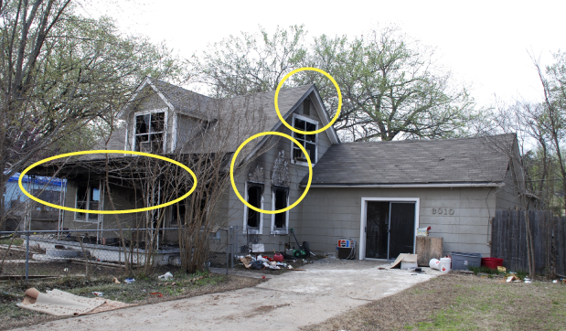
The search for area of origin at a structure fire begins outside.
Courtesy of Donny Howard

Slide 9
You should know actions to take when the origin cannot be determined.
Delay overhaul beyond locating, extinguishing fires
Protect scene
Establish scene security

Slide 10
Preliminary assessment and exterior examination require specific tasks.
Exam scene to determine
Document, preserve
Specific observations

Slide 11
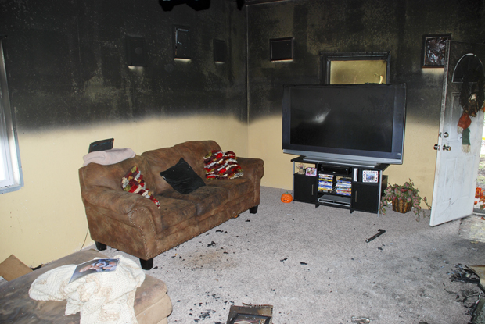
The interior examination begins in the area of least damage and works toward the area of greatest damage.
Fire patterns
Melted metal, glass
Degree of damage
Fire indicators to use:
Courtesy of Donny Howard

Slide 12
Charring on floors and vertical surfaces can indicate useful information.
Where fuel burned in that location
Face toward area or point of origin
Courtesy of Donny Howard

Slide 13
Area of origin and fire spread factors should be closely examined.
Multiple areas of origin
May indicate intentionally set
Unintentional may give same appearance
Factors affecting fire spread
Materials in fire’s path
Building features, layout
Ventilation openings
Fire load
Activation of suppression systems
Be aware of general patterns
Call investigator if there is a question
Fire suppression tactics

Slide 14
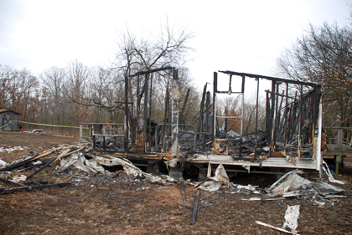
Total structural fire loss presents unique investigation challenges.
Courtesy of Donny Howard

Slide 15
Exterior fires involve several different types of materials.
Stored materials
Debris
Trash
Rubbish
Ground cover or vegetation

Slide 16
Ground cover fires require specific understanding of several concepts.
Basic fire behavior
Effects of winds
Topography
Natural fuels on fire spread
Burns outward in all directions

Slide 17
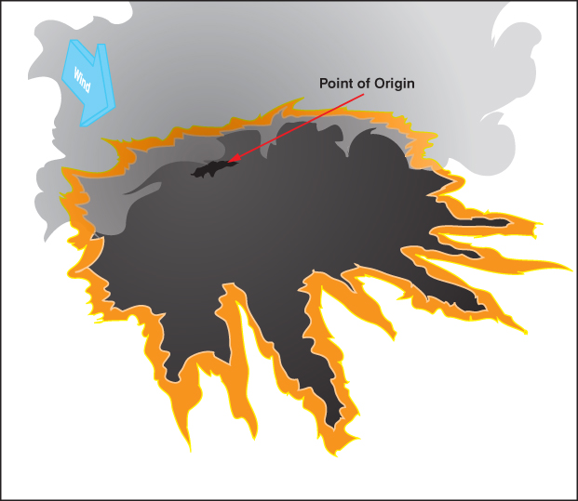
Fire burns in equal directions when on flat ground and without wind.

Slide 18
The rate and direction of spread of ground cover fires are affected by several components.
Wind direction
Terrain/topography
Ambient temperature
Wind velocity
Types of fuel
Relative humidity
Moisture content of fuel

Slide 19
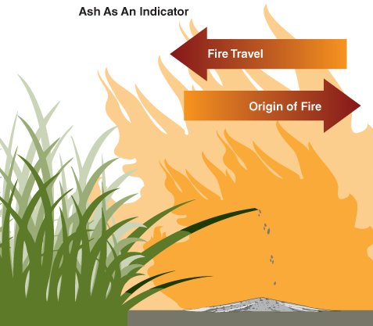
Ground cover fires require specific understanding of several concepts.
Area of origin may display
Evidence of slower, less intense fire growth
Unburned materials
Effects of flame on fuels less than at head
Radiant heat affects adjacent fuels
Backsides of grass, trunks protected
Grass will fall toward area of origin
White ash product of more complete combustion

Slide 20
Finding the area of origin for vehicle fires is similar to the structural process.
Search for area of origin
Interview witnesses, firefighters
Examine exterior, interior

Slide 21
Vehicle fires require knowledge and practice of several safety guidelines.
Ensure undeployed air bags inoperable
Ensure shock absorber bumpers inoperable
Hybrid, electric car considerations
Do not cut posts that contain restraint systems
Know where large capacity or multiple fuel cells may exist
Check trunk area for flammable/ combustibles
Hydraulic system considerations

Slide 22
WARNING
Do not attempt to access or examine a vehicle unless you know how to do so safely.

Slide 23
REVIEW QUESTION
What ways can a Firefighter I recognize obvious signs of a fire’s area of origin?

