Slide 2
Essentials of Fire Fighting
6th Edition
Firefighter I
Chapter 4 — Building Construction

Slide 3
Learning Objective 1
Describe the impact of fire on common building materials.

Slide 4
A wide variety of building materials are used in construction.
All react differently to heat of fire
Knowing reaction can help
Courtesy of Ron Moore and
McKinney (TX) FD

Slide 5
Wood is the most common material used in North America.
Also main component in structural assemblies

Slide 6
The size and moisture content of wood affects how it reacts to fire.
Small vs. large dimensions
Moisture and burn rate
New vs. old construction

Slide 7
Each type of masonry shows signs of deterioration in different ways.
Brick
Stone
Concrete/
Concrete Block
Courtesy of Ron Moore and
McKinney (TX) FD

Slide 8
The effect of heat on metal depends on the type and exposure.
Cast Iron
Wrought Iron
(Cont.)

Slide 9
The effect of heat on metal depends on the type and exposure.
STEEL
Used for structural support
Lengthens when heated
Failure at near or above 1,000°F (538°C)
Keys to keep in mind when firefighting
Courtesy of Ron Moore and McKinney (TX) FD
(Cont.)

Slide 10
The effect of heat on metal depends on the type and exposure.
Aluminum
Tin
Copper
Lead
Many uses
Affected by heat more rapidly than steel
Used for ceiling tiles, roofs
Found in wiring, pipes, gutters, decorative elements
Found in pipes, flashing, stained or leaded glass windows

Slide 11
Reinforced concrete typically performs well under fire conditions.
Fortified with rebar
Loses strength through spalling
Courtesy of Ron Moore and McKinney (TX) FD

Slide 12
Gypsum has excellent heat-resistant and fire-retardant properties.
Known as drywall, Sheetrock®
High water content
Breaks down gradually under fire conditions

Slide 13
The process of lath and plaster can present unique challenges during an incident.
May be replaced with wire mesh
Can be difficult to penetrate
Can conceal fire in cavity
May add fuel

Slide 14
Both glass and fiberglass react to heat in different ways.
Glass
Comes in many forms
Fiberglass
Typically used for insulation
Not typically used for support
Glass component not significant fuel
May be difficult to extinguish

Slide 15
DISCUSSION QUESTION
What types of insulation are commonly found in your jurisdiction?
Why is this important to know?

Slide 16
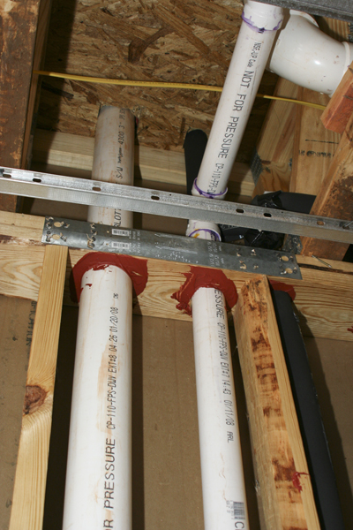
Plastic typically melts and contributes to the content load during an incident.
Exterior uses
Water, sewer pipes
Decorative use

Slide 17
Composite materials are made by combining two or more distinctly different materials.
Finger-jointed timber
Laminated timber
Medium density fiberboard
Particle board
Synthetic wood

Slide 18
REVIEW QUESTION
What impact can fire have on common building materials?

Slide 19
Learning Objective 2
Explain the impact of fire on construction classifications.

Slide 20
Construction classification type is determined by several factors.
Architect, structural engineer, contractor
Local building codes
Materials used in construction

Slide 21
Building codes are adopted and sometimes modified to meet local requirements.
Locally or nationally developed
Major US models
Canadian code
NFPA
ICC
Adopted by provincial or local government

Slide 22
Some buildings may be exempt from following local codes and renovations can also change structures.
May be exempt
Manufactured homes
Federal- or State- owned buildings
Renovations
Contain more than one construction method
May improve fire safety
May create potential hazards

Slide 23
The IBC® and NFPA® classify five types of construction.
Type I
Type II
Courtesy of Ron Moore and McKinney (TX) FD
(Cont.)

Slide 24
The IBC® and NFPA® classify five types of construction.
Type III
(Cont.)

Slide 25
DISCUSSION QUESTION
What types of renovations are commonly found in your jurisdiction?
How can firefighters monitor these?

Slide 26
The IBC® and NFPA® classify five types of construction.
Type V
Type IV

Slide 27
Manufactured homes are not required to conform to model building codes.
Built in factory
Must conform to U.S. HUD standard
Fire-resistance may vary

Slide 28
There are three types of construction defined by the National Building Code of Canada.
Combustible
Noncombustible
Heavy timber

Slide 29
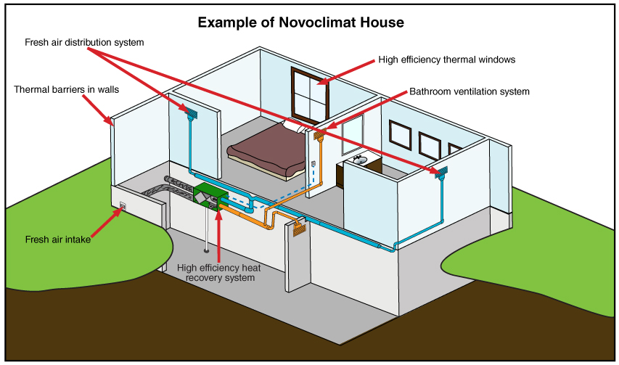
Canadian construction may also be designed with the Novoclimat standard.

Slide 30
REVIEW QUESTION
How are different construction classifications affected by fire suppression?

Slide 31
Learning Objective 3
List the main types of occupancy classifications.

Slide 32
Occupancy classifications are defined by building and life safety codes.
Single-use
Separated use

Slide 33
REVIEW QUESTION
What are the main types of occupancy classifications?

Slide 34
Learning Objective 4
Describe the basic construction of building components.

Slide 35
Foundations are designed to support the weight of the building and its contents.
Shallow
Deep

Slide 36
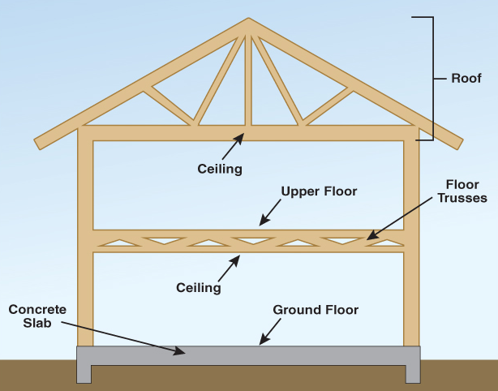
Floors and ceilings form the top and bottom of the compartment.

Slide 37
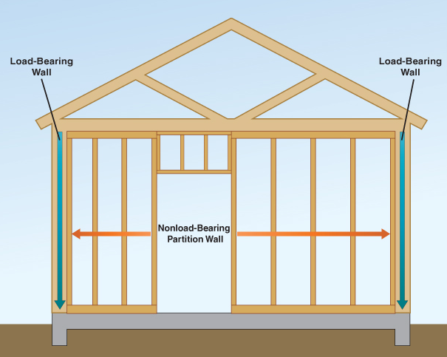
Walls define the perimeter of a building and divide it into compartments.

Slide 38
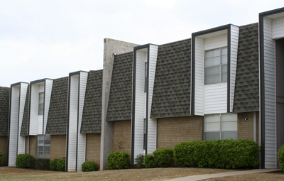
Wall types and ratings vary depending on several factors.

Slide 39
Fire walls are constructed of a variety of masonry materials.
Provide separation
Assemblies
May be party walls
Can divide structures

Slide 40
Penetrating walls should only be performed when needed.
Exterior and fire walls
Interior walls
Most difficult
Forcing entry into or escaping
Only to locate hidden fires or create escape path

