Slide 2
Roofs primarily protect a structure and its contents from the effects of weather.
(Cont.)

Slide 3
Roofs primarily protect a structure and its contents from the effects of weather.

Slide 4
DISCUSSION QUESTION
How does knowing that arched roofs contribute to firefighter casualties impact your need to understand building construction?
What types of arched roofs are common in your jurisdiction?

Slide 5
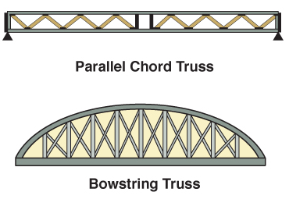
Roof construction is based on three main components; one is roof supports.
Courtesy of Ron Moore and McKinney (TX) FD

Slide 6
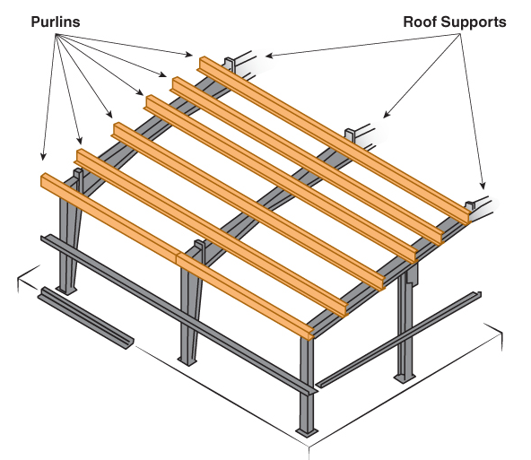
Roof decks are another component in roof construction.

Slide 7
Roof coverings, the final main component, come in a variety of styles.
Wood shingles
Terracotta
Tar and gravel waterproofing
Metal

Slide 8
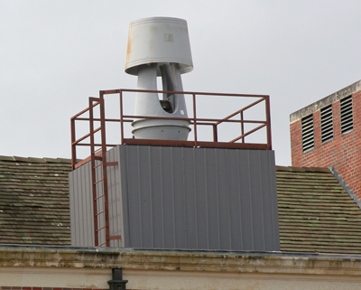
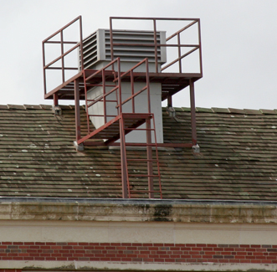
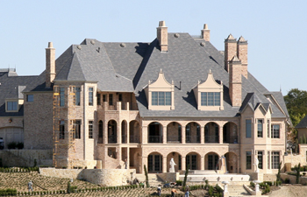
Roof penetrations and openings may indicate the locations of some rooms.
Examples

Slide 9
Observing the presence of roof obstructions can help when ventilating.
Green roof
Cold roof
(Cont.)

Slide 10
Observing the presence of roof obstructions can help when ventilating.
Photovolatic roof
Rain roof

Slide 11
Security measures on roofs and other areas can cause obstructions as well.
Mounted over doors, windows
May be on skylights
May be installed by owner

Slide 12
WARNING
Unauthorized security modifications create extreme life safety hazards for firefighters.

Slide 13
Structural modifications should, but do not always, meet local building codes.
Permitted modifications
Nonpermitted modifications
Stay aware of those in your response area
Can inhibit effective ventilation and increase risk of collapse

Slide 14
Roof-mounted equipment can add a live load to the dead load on a roof.

Slide 15
Stairs provide access to or egress from different levels of a structure.

Slide 16
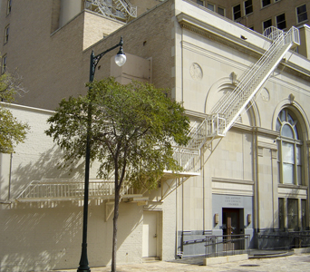
Exterior stairs and fire escapes provide access and egress in different ways.

Slide 17
DISCUSSION QUESTION
Why might fire escapes not be able to support the weight of a firefighter?

Slide 18
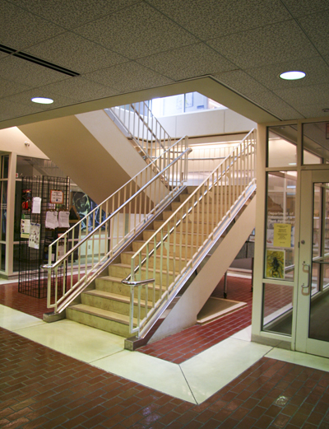
Smokeproof and unprotected stairs provide different levels of protection.

Slide 19
Doors vary widely in operation, style, design, and construction.
Swinging
Sliding
Folding
(Cont.)

Slide 20
Doors vary widely in operation, style, design, and construction.
Vertical
Revolving

Slide 21
Wood panel and flush doors are constructed using similar components.

Slide 22
Glass and metal doors can be constructed in a variety of ways.
Glass
Metal

Slide 23
Fire doors can be effective at limiting fire spread when properly maintained.
Fire door
Rolling fire door
Sliding fire door
Courtesy of Ron Moore and
McKinney (TX) FD

Slide 24
Window construction uses the same components for many styles.

Slide 25
Fixed windows are nonoperable, these may be called display windows.

Slide 26
Movable windows come in a variety of styles, depending on the structure’s requirements.
(Cont.)

Slide 27
Movable windows come in a variety of styles, depending on the structure’s requirements.
(Cont.)

Slide 28
Movable windows come in a variety of styles, depending on the structure’s requirements.
(Cont.)

Slide 29
Movable windows come in a variety of styles, depending on the structure’s requirements.

Slide 30
Security windows also come in different configurations.

Slide 31
REVIEW QUESTION
In what ways can building components impact fire suppression efforts?

Slide 32
Summary
Your safety when fighting fire depends on your ability to know how the building will contribute to and even control the spread of fire.
You must also understand the effect fire and heat have on structural components and materials to be able to anticipate results.

