Slide 2
Essentials of Fire Fighting
6th Edition
Firefighter I
Chapter 7 — Portable Fire Extinguishers

Slide 3
Learning Objective 1
Explain portable fire extinguisher classifications.

Slide 4
Portable fire extinguishers are chosen based on the type of fuel burning.
Class A
Class B
Class C
Class D
Class K

Slide 5
Class A fires involve ordinary combustibles.
Fuel
Textiles
Paper
Plastics
Rubber
Wood
Extinguished with:
Water
Water-based agents (Class A foam)
Dry Chemicals

Slide 6
Class B fires involve flammable, combustible liquids and gases.
Fuel
Alcohol
Gasoline
Lubricating Oils
Liquefied petroleum gas (LPG)
Extinguished with:
Carbon Dioxide
Dry Chemicals
Class B Foam

Slide 7
Class C fire involves energized electrical equipment.
Treat as Class A or B once power is off

Slide 8
Class D fires involve combustible metals and alloys.
Lithium
Magnesium
Potassium
Sodium

Slide 9
CAUTION!
The use of water or water-based agents on Class D fires will cause the fire to react violently, emit bits of molten metal, and possibly injure firefighters close by.

Slide 10
Use dry powder, not dry chemical, extinguishers on Class D fires.
Dry powder
Dry chemical

Slide 11
CAUTION!
Do not use a dry chemical extinguisher on Class D fire. The dry chemical often reacts violently with burning metals.

Slide 12
Class K fires involve combustible cooking oils.
Vegetable or animal fats
Burn at extreme temperatures
Found at commercial, institutional, industrial, home
Controlled by wet chemical systems, portable extinguishers

Slide 13
REVIEW QUESTION
How are the classifications for portable fire extinguishers divided?

Slide 14
Learning Objective 2
Describe types of portable fire extinguishers.

Slide 15
Fire extinguishers are organized by type of extinguishing agent and the method used to expel their contents.
Extinguishing agent
Cooling – Reduces temperature
Smothering – Excludes oxygen
Chain breaking – Interrupts chemical chain reaction
Saponification – Forms oxygen-excluding foam
(Cont.)

Slide 16
Fire extinguishes are organized by type of extinguishing agent and the method used to expel their contents.
Manual pump – Physical pressure forces agent out nozzle
Stored pressure – Compressed air or inert gas forces agent out nozzle
Pressure cartridge – External expellant forces agent out nozzle when introduced to container
Mechanisms to expel

Slide 17
Use pump-type water extinguishers on small Class A fires, ground cover fires.

Slide 18
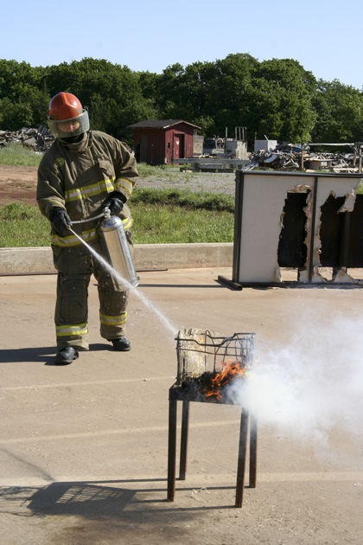
Use stored-pressure water extinguishers on small Class A fires.

Slide 19
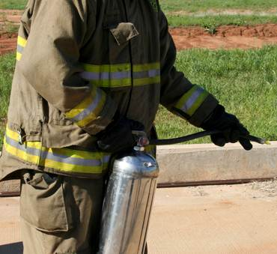
Use water-mist stored-pressure extinguishers on Class C fires.
Deionized water
Water-mist stored-pressure
Normal water
Stored-pressure water

Slide 20
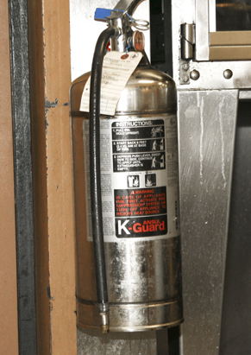
Use wet chemical stored-pressure extinguishers on Class K fires.
Potassium based, low pH
Courtesy of Ron Moore/McKinney (TX) FD
Saponification

Slide 21
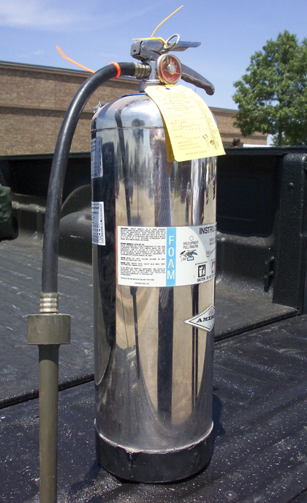
Use aqueous film forming foam (AFFF) extinguishers on Class B fires, small fuel spills.

Slide 22
Clean agent extinguishers replaced halogenated agents.
Rapidly evaporating liquid that leaves no residue
Cools, smothers Class A and B fires
Nonconductive, safe on energized electrical equipment
Courtesy of Ansul Corp.

Slide 23
REVIEW QUESTION
What are the differences between wet chemical stored-pressure, aqueous film forming foam (AFFF), and clean agent extinguishers?

Slide 24
Carbon dioxide (CO₂) extinguishers discharge as a gas and are most effective on Class B and C fires.
Have limited reach
Easily dispersed by wind
No freeze protection required

Slide 25
CO₂ is stored under its own pressure and is discharged through a plastic or rubber horn.
CO₂
Smothers fire
Little cooling effect
Reignition possible
O₂
Dry ice crystals

Slide 26
CAUTION!
When carbon dioxide is discharged, a static electrical charge builds up on the discharge horn. Touching the horn before the charge has dissipated can result in a shock.

Slide 27
Operate wheeled (CO₂) extinguishers in the same manner as handhelds.
Commonly found in airports and industrial facilities
Courtesy of Badger Fire Protection

Slide 28
Dry chemical extinguishers use additives to keep extinguishing agents ready for use, even after long storage periods.
Regular
B:C rated
Multipurpose
A:B:C rated

Slide 29
Dry chemical extinguishers may react chemically with other types of extinguishing agents.
Dry chemical
Other agents

Slide 30
WARNING!
Never mix or contaminate dry chemicals with any other type of agent.

Slide 31
Dry chemical agents are considered nontoxic and safe for use.
May reduce visibility
May create respiratory problems
May not be compatible with foam

Slide 32
Follow these steps when using dry chemical extinguishers on Class A fires.
1. Direct discharge to cover with chemical
2. After flames knocked down, apply to smoldering area

Slide 33
Handheld dry chemical extinguishers come in two basic designs.
Cartridge- operated
Pressure cartridge connected
Tank not pressurized until plunger pushed
Stored pressure
Similar to air-pressurized water
Constant pressure around 200 psi (1 400 kPa)

Slide 34
CAUTION!
When pressurizing a cartridge-type extinguisher, do not place your head or any other part of your body above the top of the extinguisher. If the fill cap was not properly screwed back on, the cap and/or a cloud of agent can be forcibly discharged.

Slide 35
Wheeled dry chemical extinguishers operate in a similar manner as handheld cartridge-types.
Stretch out hose completely;
powder can clog
Prepare for significant
nozzle reaction
Pressurizing gas
Agent
Allow few seconds to pressurize
after introducing gas

Slide 36
CAUTION!
The top of the extinguisher should be pointed away from the operator and any other nearby personnel when pressurizing the unit.

Slide 37
Use dry powder extinguishers on fires for Class D metals.
No single agent works on all metals
Comes in several models
Consult manufacturer’s guide
Apply with extinguisher or scoop

Slide 38
Dry powder creates a smothering blanket over burning area.
Apply sufficient depth
Apply gently; do not break crust
Avoid scattering

Slide 39
CAUTION!
Water applied to a combustible metal fire results in a violent reaction that intensifies the combustion and causes bits of molten material to spatter in every direction.

Slide 40
Follow these steps if burning metal is on a combustible surface.
1. Cover fire with powder
2. Create layer of powder nearby, 1-2 inches (25-50 mm) deep
3. Spread nearby – Add more as needed
4. Leave undisturbed until completely cool

Slide 41
REVIEW QUESTION
How do carbon dioxide (CO₂), dry chemical, and dry powder extinguishers differ?

