Slide 2
Learning Objective 3
Define the ratings in a portable fire extinguisher rating system.

Slide 3
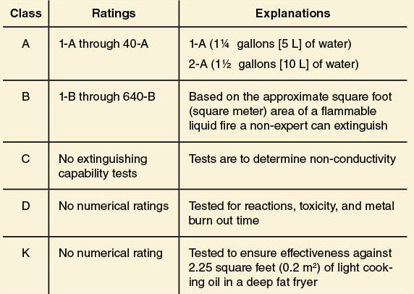
Fire extinguishers are rated according to performance capability.
(Cont.)

Slide 4
Fire extinguishers are rated according to performance capability.
A
Based on amount of agent, duration, and range of discharge
B
Based on approximate area that nonexpert can extinguish with full extinguisher
C
No specific capability testing except for nonconductivity
D
Based on type of combustible metal
K
Based on capability of saponifying cooking oils

Slide 5
Fire extinguishers rated for multiple classes of fire are identified by a combination of letters.
Ratings for each class do not affect each other
Class A-B-C
Class A-B
Class B-C
Use for intended purpose only

Slide 6
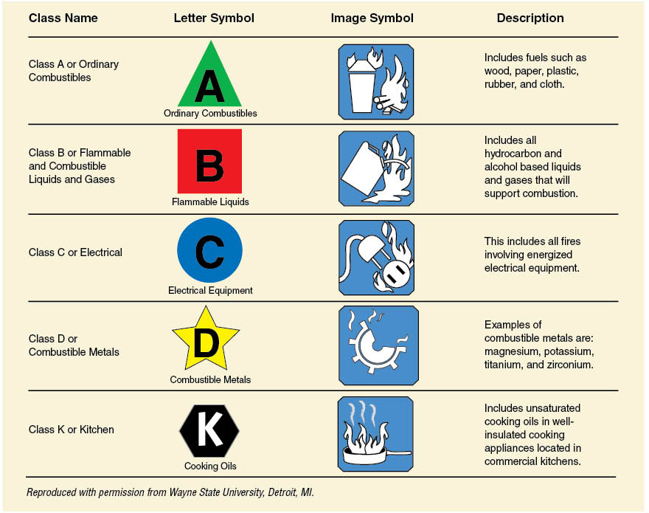
Fire extinguishers are identified by colored geometric shapes or pictographs.

Slide 7
REVIEW QUESTION
How are the ratings used for portable fire extinguishers determined?

Slide 8
Learning Objective 4
Explain the considerations taken when selecting and using portable fire extinguishers.

Slide 9
Fire extinguishers are chosen to achieve two main goals.
Minimize risk to life and property
Effectively extinguish fire

Slide 10
Consider several factors when selecting the proper fire extinguisher.
Fuel classification
Rating
Hazards
Fire size, intensity
Atmospheric conditions
Training
Ease of handling
Life hazards
Operational concerns

Slide 11
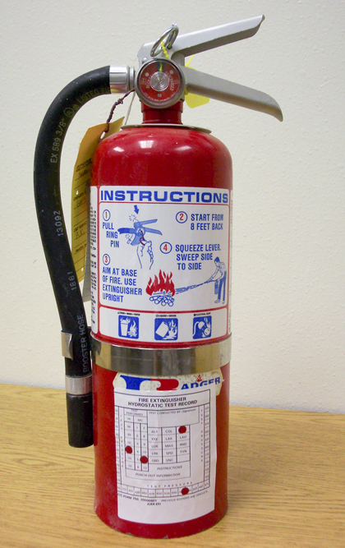
Use clean agent or CO₂ extinguishers in areas with computer equipment.
Dry chemicals can be damaging

Slide 12
Operating procedures for all fire extinguishers are similar, but be familiar with label instructions.
Courtesy of Ansul Corp.

Slide 13
Note
Wear full structural or wildland fire fighting personal protective equipment including appropriate respiratory protection when operating any portable fire extinguisher. Even small incipient fires will produce toxic gases that can injure you.

Slide 14
After you select the extinguisher make a quick visual inspection.
External condition
Hose/nozzle
Weight
Pressure gauge

Slide 15
Follow these general steps for using fire extinguishers.
Approach with wind at back
Pick up and carry by handles
(Cont.)

Slide 16
Follow these general steps for using fire extinguishers.
Be sure agent reaches fire
Apply from appropriate distance
After fire reduces in size
If not extinguished after full discharge, withdraw and reassess
If solid fuel, use appropriate tool to overhaul
If liquid fuel, appropriate foam may be necessary

Slide 17
Remember the following considerations when using extinguishers.
Extinguishers are first-aid appliances
Work in unison if more than one
Lay empty extinguishers on their side

Slide 18
REVIEW QUESTION
When using a portable fire extinguisher, how can you determine the best way to use it?

Slide 19
Learning Objective 5
Identify procedures used for the inspection, care, and maintenance of portable fire extinguishers.

Slide 20
Inspection, care, and maintenance of extinguishers are mandated by a number of organizations.
Fire departments
Specified by local SOPs
Based on NFPA® 10
Privately owned
Regulated by locally adopted codes

Slide 21
NFPA® 10 requires at least an annual inspection; local SOPs establish policy.
Factors determining value
Accessibility
Simplicity
Serviceability

Slide 22
Follow these general procedures for every extinguisher inspection.
 In proper location, accessible
 Nozzle/horn unobstructed
 Hose free of cracks, dirt, grease
 Shell free of damage
(Cont.)

Slide 23
Follow these general procedures for every extinguisher inspection.
 Seal and pin not tampered with
 Filled and fully pressurized; if deficient by 10% weight, remove from service
 Check inspection tag
 Instructions are legible

Slide 24
Follow these steps if any extinguishers are found to be deficient.
2. Replace with operational extinguisher
3. Report need for service
Only trained personnel should repair or refill
1. Remove from service

Slide 25
Follow these general guidelines when caring for extinguishers.
Never drop or throw
Carry according to size and weight
Remove pin only when ready to use
Store securely
(Cont.)

Slide 26
Follow these general guidelines when caring for extinguishers.
Lay on side
when empty
Do not store/stack items in front of
wall- mounted
Shake dry chemical monthly

Slide 27

Clean extinguishers periodically and after every use.
Avoid solvents that damage plastic parts
Use steel wool or sand paper to remove corrosion
Only trained personnel should repair or refill
Warm water, soap to remove dirt, grease

Slide 28
Extinguishers should be removed from service for annual maintenance.
Includes thorough inspection, disassembly
Pressurized units must be hydrostatically tested
NFPA® 10
Required by U.S. DOT and Transport Canada
Test results affixed to shell
Dry chemical units emptied, refilled every six years

Slide 29
CAUTION!
Never attempt to repair the shell or cylinder of a defective fire extinguisher. Contact the manufacturer for instructions on where to have it repaired or replaced.

Slide 30
REVIEW QUESTION
What are the basic procedures for the care and maintenance of portable fire extinguishers?

Slide 31
Summary
Portable fire extinguishers can control or extinguish small incipient or early growth stage fires quickly in the hands of trained personnel; you must be familiar with their characteristics and be able to select and use them properly.
(Cont.)

Slide 32
Summary
Not only should you be familiar with their characteristics and be able to select and use them properly, you must also be able to educate the public.
Inspecting, caring for, maintaining extinguishers assigned to your apparatus and facility are also important skills for you to have.

