Slide 1
Learning Objective 4
Describe webbing and webbing construction.

Slide 2
Webbing comes as either flat or tubular in either spiral or chain weave.
Made from same material as synthetic rope
Life safety webbing must be NFPA® compliant

Slide 3
Life safety webbing is used for four different purposes.
Construct technical rescue anchor systems
Package and secure victims to litters
Fasten rescue components together
Support firefighters during technical rescue

Slide 4
Utility webbing is not regulated by a standard.
Must support load limit plus safety factor
Used for variety of tasks

Slide 5
REVIEW QUESTION
What are the two main uses for webbing?

Slide 6
Webbing care and maintenance procedures are similar to rope.
Follow same guidelines as synthetic fiber rope
Always follow manufacturer’s instructions

Slide 7
Webbing is stored in several ways.
Carried in protective coat pocket
Rolled or daisy-chained
Kept in bags
Carried in apparatus

Slide 8
Learning Objective 5 and 6
Describe parts of a rope and considerations in tying a knot.
Describe knot characteristics and knot elements.

Slide 9
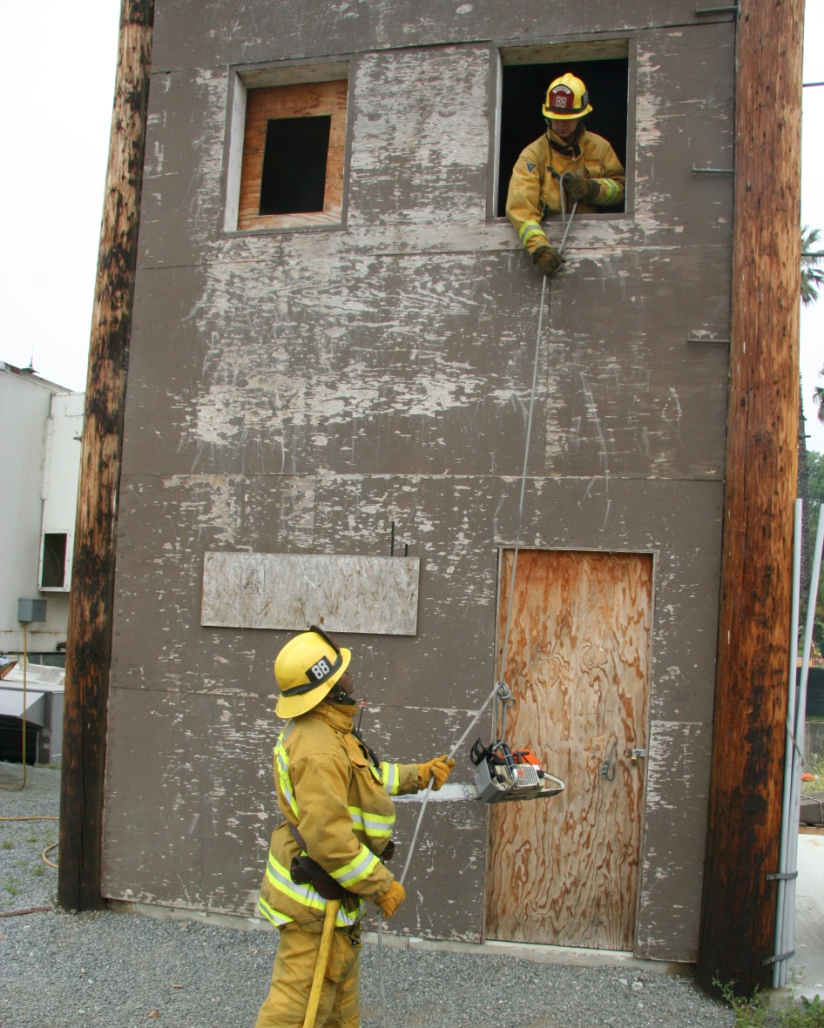
Knots play a critical part in fire fighting and are made up of three parts.
Running part
Standing part
Working end

Slide 10
Tighten all knots, remove all slack after tying (dressing), and use safety knots to ensure safety.
Overhand safety knot
Clove hitch
Courtesy of Shad Cooper/Wyoming
State Fire Marshal’s Office

Slide 11
All knots tied by firefighters follow these basic principles.
Easy to tie
Secure under load
Reduce rope strength as little as possible, avoid tight bends

Slide 12
Three bends are created when tying a knot or hitch.
Bight
Loop
Round turn

Slide 13
REVIEW QUESTION
What are the three parts of a knot?

Slide 14
Learning Objective 7
Describe characteristics of knots commonly used in the fire service.

Slide 15
Firefighters use several types of knots for a variety of reasons.
Overhand safety knot
Bowline
Used as a safety measure
Easily tied and untied
Courtesy of Shad Cooper/Wyoming
State Fire Marshal’s Office
(Cont.)

Slide 16
Firefighters use several types of knots for a variety of reasons.
Half-hitch
Clove hitch
Used to stabilize long objects while hoisting, combined with other knots
Attach rope to object, not used in life safety
(Cont.)

Slide 17
Firefighters use several types of knots for a variety of reasons.
Handcuff (Rescue)
Figure-Eight
Used to secure victim’s hands, feet
Can be used as stopper knot
(Cont.)

Slide 18
Firefighters use several types of knots for a variety of reasons.
Figure-Eight bend
Figure-Eight on bight
Used to tie together two ropes of equal diameter
Used to tie closed loop
(Cont.)

Slide 19
Firefighters use several types of knots for a variety of reasons.
Figure-Eight follow through
Becket bend
Used for securing objects
Used joining unequal diameter rope or chain, not life safety
(Cont.)

Slide 20
Firefighters use several types of knots for a variety of reasons.
Water knot
Used for joining two pieces of webbing, tendency to slip

Slide 21
REVIEW QUESTION
What are the three main elements of a knot that can be combined to create knots and hitches?

Slide 22
Learning Objective 8
Select commonly used rope hardware for specific applications.

Slide 23
Learning Objective 9
Summarize hoisting safety considerations.

Slide 24
Ropes and webbing have five main uses at emergency incidents.
Rescue (life safety rope only)
Hoist tools, equipment
Barrier to control zone
Search line
Stabilization
Never exceed the load ability of a rope.

Slide 25
Specially trained rescuers use life safety rope, never utility rope.
Rappelling
Lifting victims and rescuers
Ice, swift water rescue

Slide 26
Always keep safety first when hoisting tools and equipment.
Hoisting SCBA prohibited by OSHA
Use proper knots, securing procedures
Control or tag line may be used

Slide 27
Follow these general safety guidelines when hoisting.
 Avoid hoisting near electrical hazards
 Secure nozzles of charged hoselines
 Use tag line to control object
 Hand carry if safer

Slide 28
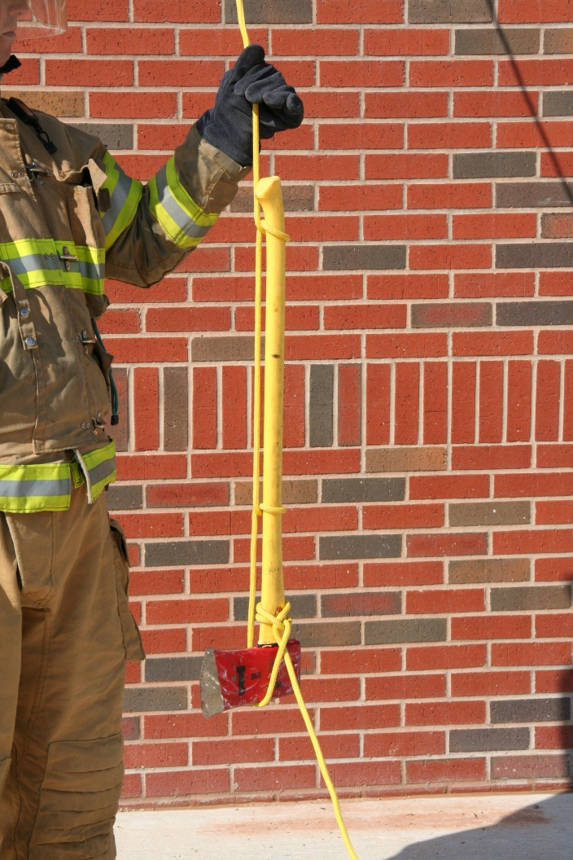
Firefighters must learn to hoist several types of equipment.
(Cont.)
Axe
Pike Pole

Slide 29
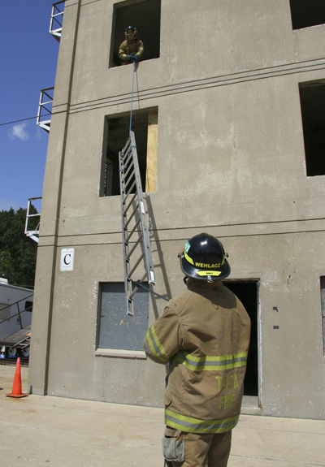
Firefighters must learn to hoist several types of equipment.
- Often fastest and safest
- Dry hoseline safer than charged
(Cont.)
Ladder
Dry hoseline

Slide 30
Firefighters must learn to hoist several types of equipment.
- Knot and tagline through closed handle
Courtesy of Shad Cooper/Wyoming
State Fire Marshal’s Office
Rotary saw
(Cont.)

Slide 31
REVIEW QUESTION
What are three safety guidelines that must be used when hoisting tools or equipment?

Slide 32
Utility rope has traditionally been used for control zone perimeters.
Courtesy of Shad Cooper/Wyoming State Fire Marshal’s Office

Slide 33
Search lines help firefighters stay in contact and provide a physical means of finding an exit.
Courtesy of Shad Cooper/Wyoming State Fire Marshal’s Office

Slide 34
Utility rope is used to stabilize objects and prevent vehicles from falling or rolling over.
1. Tie to strong, stationary object
2. Tie to vehicle

Slide 35
Before stabilizing any object, be sure to complete the following.
Ensure rope, webbing, anchors strong enough to bear weight
Tighten knots, have safety knots in place
Ensure all attachment points secure, will not pull free
Ensure personnel are clear in case line snaps, breaks

Slide 36
Summary
Firefighters use rope and webbing to hoist tools and equipment, stabilize objects, designate control zones, perform rescues, and escape from life-threatening situations.

Slide 37
Summary
To use them safely and effectively, you must know the various types of ropes, their applications, and how to tie a variety of knots quickly and correctly.
Finally, you must know how to inspect, clean, maintain, and store ropes and webbing so that they are ready for use when needed.

